Slide 1


CSA0764 - COMPUTER NETWORKS FOR A GAME SERVER
DESIGN, SIMULATION, AND ANALYSIS OF IPV6 ADDRESSING AND SUBNETTING SCHEMES
Presented by:
A Kailash Venkata Sai[192525069]
R Sanjay Krishnan[192521055]
M Sohail Khan [192525046]
Guided By :
Dr Senthil K
Dr Rajaram P

Slide 2
Introduction
Overview Of The Project :
This project designs an IPv6 addressing and subnetting scheme for modern networks.
The IPv6 network is simulated to check connectivity and routing.
The performance and scalability of the IPv6 design are analyzed.
Problem Statement :
IPv4 address space is limited and cannot support the growing number of network devices.
Improper addressing and subnetting make large networks difficult to manage and scale.
There is a need for an efficient IPv6 addressing and subnetting scheme to improve network performance and future expansion.
.
Purpose Of The Project :
To design an efficient IPv6 addressing and subnetting scheme.
To simulate the IPv6 network and verify connectivity.
To analyze the performance and scalability of the IPv6 design.

Slide 3
.
Objectives
Addressing the problem statement :
The project adopts IPv6 to solve the problem of limited IPv4 addresses.
A structured IPv6 addressing and subnetting scheme is designed for easy management.
The design is tested through simulation to ensure efficient and scalable networking.
Final Outcome :
IPv4 cannot support the increasing number of network devices due to limited addresses.
Poor addressing and subnetting make large networks hard to manage.
IPv6 addressing and subnetting are needed for scalable and efficient networks

Slide 4
Literature Review
Title | Author & Year | Methodology | Key Findings
“Evaluating IPv6 Adoption in the Internet” | Lorenzo Colitti, Steinar H. Gunderson, Erik Kline, Tiziana Refice,2010 | Measurement-based evaluation from the perspective of a large service provider (Google). | IPv6 native latency is comparable to IPv4 IPv6 deployment is increasing but adoption remains uneven globally.
“Research on the Security of IPv6 Communication Based on Petri Net under IoT” | X. et al.,2023 | Designed attack/defense Petri Net models to simulate IPv6 NDP processes. | • IPv6 Neighbor Discovery Protocol (NDP) is vulnerable to reconnaissance & DoS attacks in IoT.
“A Review Paper on IPv4 and IPv6: A Comprehensive Survey” | Md. Turab Hossain, Jesmin Zaman Binti, Md. Rayhan Uddin.,2024 | • Comprehensive literature survey of IPv4 vs IPv6. • Analyzed addressing, operational challenges, and migration mechanisms across scholarly work. | IPv6 resolves IPv4 exhaustion with a vastly larger address space. IPv6 adoption requires careful planning and deployment strategies.
“6Graph: A Graph-Theoretic Approach to Address Pattern Mining for Internet-wide IPv6 Scanning” | Zhu et al.,2022 | Divided IPv6 address space into regions via structural grouping. | Existing IPv6 scanning techniques have low hit rates due to poor target generation.
“A New Hybrid Method of IPv6 Addressing in the Internet of Things” | Nasrin Sadat Zarif, Hamed Najafi, Mehdi Imani, Abolfazl Qiyasi Moghadam.,2018 | • Divided IPv6 address space into regions via structural grouping. • Converted regions into graphs and applied density-based clustering. | Standard IPv6 addressing may not scale efficiently for IoT due to heterogeneous node requirements.

Slide 5
Methodology:
Tools and Frameworks Used :
Cisco Packet Tracer – used to design and simulate the IPv6 network topology.
IPv6 Protocol Suite – used for addressing, subnetting, and routing configuration.
OSPFv3 Routing Protocol – used to enable and test IPv6 routing between networks.
Development Approach :
Study IPv6 addressing, subnetting concepts, and network requirements.
Design the IPv6 address plan and network topology.
Implement and test the design using network simulation tools.
Data Collection :
IPv6 standards and addressing guidelines were collected from textbooks and online documentation.
Network requirements such as number of subnets and hosts were identified.
Simulation results like connectivity status and routing information were collected for analysis.

Slide 6
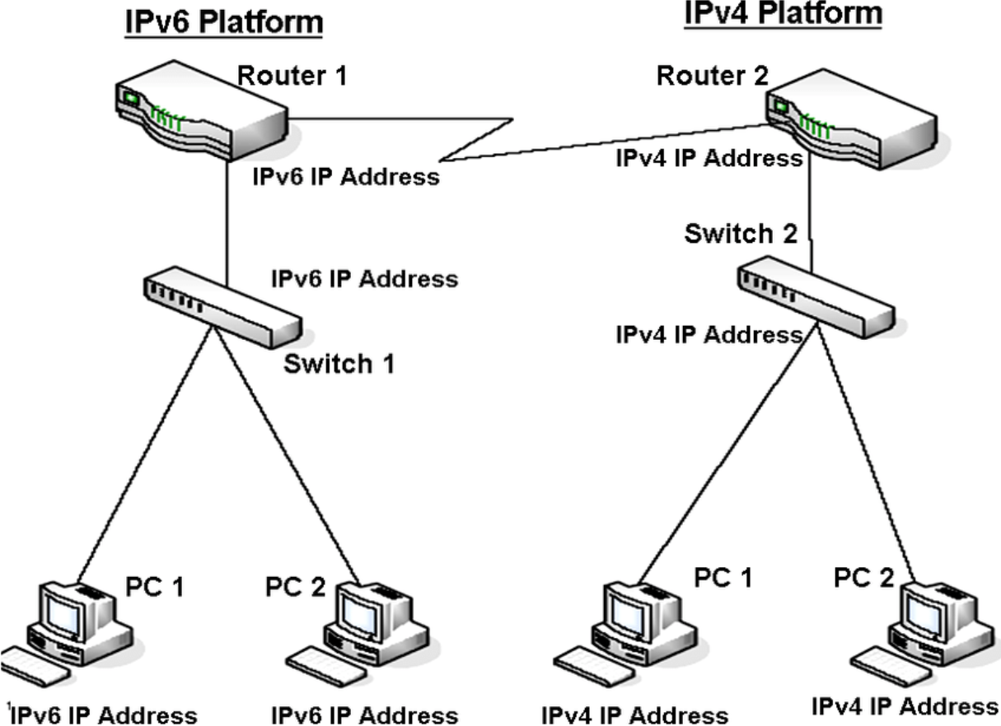
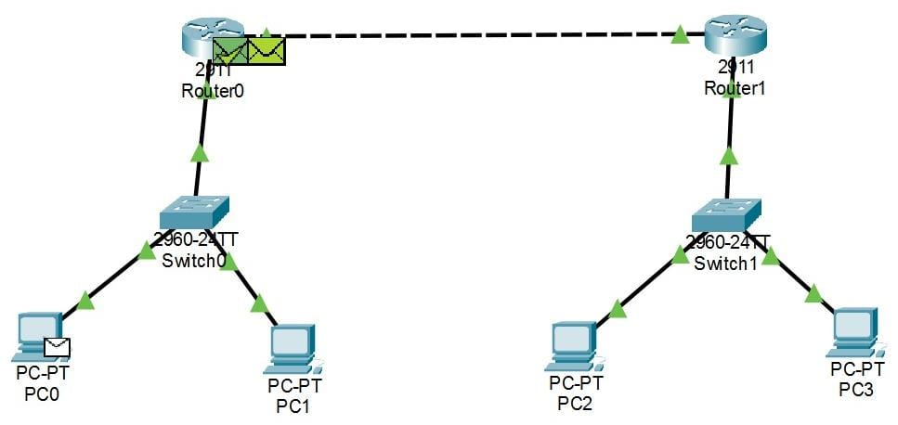
System Design / Architecture
Technology stack used :
IPv6 Protocol: Used for addressing and subnetting to support scalable and future-ready networks.
OSPFv3 & SLAAC: OSPFv3 enables IPv6 routing, while SLAAC provides automatic address configuration.
Cisco Packet Tracer: Used to design, simulate, and test the IPv6 network topology and connectivity.

Slide 7
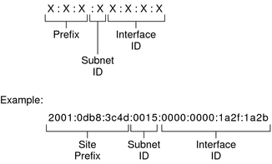
Implementation
Module 1 : IPv6 Addressing Scheme
Devices Used :
IPv6 Address Structure Diagram
Device Type, | Model / Details | Purpose
Router | Cisco Router (IPv6 supported) | Connects different IPv6 subnets and performs routing
Switch | Generic PT Switch | Connects multiple devices within the same IPv6 subnet
PC / Host | Generic PT PC | End device for testing IPv6 connectivity
Network Simulator | Cisco Packet Tracer | Used to design and simulate the IPv6 network
Ethernet Cable | Copper Straight-through | Connects PCs, switches, and routers

Slide 8
IPv6 Address Planning Table :
Network Segment | IPv6 Prefix | Prefix Length | Assigned Devices | Purpose
LAN 1 | 2001:DB8:1::/64 | /64 | PCs, Laptops, End Hosts | Provides IPv6 connectivity to end user devices
LAN 2 | 2001:DB8:2::/64 | /64 | Department Systems, Servers | Used for departmental communication and services
WAN Link | 2001:DB8:3::/64 | /64 | Router Interfaces | Enables IPv6 communication between routers

Slide 9
Module 2:Subnetting Techniques in IPv6
Port Assignment:
Switch To Router Connections :
Device | Ports | Connects To | Port
PC1 | FastEthernet0 | Switch 0 | FastEthernet0/1
PC2 | FastEthernet0 | Switch 0 | FastEthernet0/1
PC3 | FastEthernet0 | Switch1 | FastEthernet0/1
PC4 | FastEthernet0 | Switch1 | FastEthernet0/1
Switch | Ports | Connects To | Router
Switch0 | FastEthernet0/24 | Router 0 | GigabitEthernet0/0
Switch1 | FastEthernet0/24 | Router 1 | GigabitEthernet0/0
Router To Router Connection (WAN Link):
Router | Port | Connects To | Router
Router0 | GigabitEthernet0/1 | Router1 | GigabitEthernet0/1

Slide 10
Module 3: IPv6 Simulation and Analysis Tools
Objective :
To analyze IPv6 packet transmission using PDU simulation.
Tool Used :
Cisco Packet Tracer (Simulation Mode)
PDU Analysis :
ICMPv6 packet sent from source PC
Packet passes through switches and routers
IPv6 routing decisions verified
Echo Reply confirms successful communication
Outcome :
Correct IPv6 addressing and routing validated

Slide 11
Results & Discussion
Outcomes of the Project :
Designed a structured IPv6 addressing and subnetting scheme suitable for modern networks.
Simulated the IPv6 network to verify proper address allocation and end-to-end connectivity.
Analyzed the network to ensure scalability, efficient routing, and easy management.
Improved scalability and simplified network management
Gained practical knowledge of IPv6 and routing concepts
Feature | Traditional IPv4 Network | IPv6 Addressing & Subnetting (Our Project)
Address Space | Limited, address exhaustion | Very large, virtually unlimited
Scalability | Low – difficult to expand | High – easy to add new networks
Subnetting | Complex and restrictive | Simple and flexible (/64 standard)
Configuration | Manual or DHCP dependent | Auto-configuration using SLAAC
Routing Efficiency | Larger routing tables | Hierarchical and efficient routing

Slide 12
Challenges & Limitations
Issues faced during development :
Understanding IPv6 address format and prefix length
Correct configuration of IPv6 routing (OSPFv3)
Initial connectivity and configuration errors
Tool limitations during simulation
Debugging address and routing issues
Possible constraints :
Limited support for IPv6 in older devices
Learning curve for IPv6 addressing and routing
Simulation tools have feature limitations
Lack of real-time deployment environment
Network scalability testing constraints

Slide 13
Future Scope
Enhancements or improvements :
Security features such as IPsec can be implemented in the IPv6 network.
Advanced routing protocols and traffic analysis can be added for better performance evaluation.
The design can be extended to support IoT, cloud, and large-scale enterprise networks.
Future Enhancements :
Implement advanced IPv6 security mechanisms.
Integrate IoT and cloud-based networking.
Perform real-time deployment and performance analysis.

Slide 14
Conclusion:
Summary of the project :
Designed an efficient IPv6 addressing and subnetting scheme
Simulated the IPv6 network to verify connectivity
Analyzed scalability and routing performance
IPv6 supports future network growth
Simplifies network management
Key takeaways :
IPv6 solves the IPv4 address limitation
Subnetting in IPv6 is simple and scalable
Simulation confirms reliable connectivity
IPv6 improves routing efficiency
Suitable for future networks

Slide 15
References
Kumar, R. and Shinde, P.R., 2021. Computer Network-IP Address & Subnetting. International Journal of Engineering and Advanced Technology (IJEAT), 5(4), pp.242-246.
Coffeen, T., 2014. IPv6 address planning: designing an address plan for the future. " O'Reilly Media, Inc.".
Amaadid, M., El Ksimi, A. and Ettaki, B., 2025. IPv6 security challenges: A comprehensive study of current issues and real case simulation. International Journal of Communication Networks and Information Security, 17(2), pp.18-33.
Mohamad Aminuddin, M., 2022. Simulation on IPv6.
Jain, N., Payal, A. and Jain, A., 2021. Performance analysis of routing protocols on IPv4 and IPv6 addressing networks. Journal of Web Engineering, 20(5), pp.1389 1428.
Tian, Y.C. and Gao, J., 2023. Network addressing architecture. In Network Analysis and Architecture (pp. 161-219). Singapore: Springer Nature Singapore.
Savolainen, T., Soininen, J. and Silvarajan, B., 2022. IPv6 addressing strategies for IoT. IEEE Sensors Journal, 13(10), pp.3511-3519.

Slide 16
THANK YOU

